Slide 1

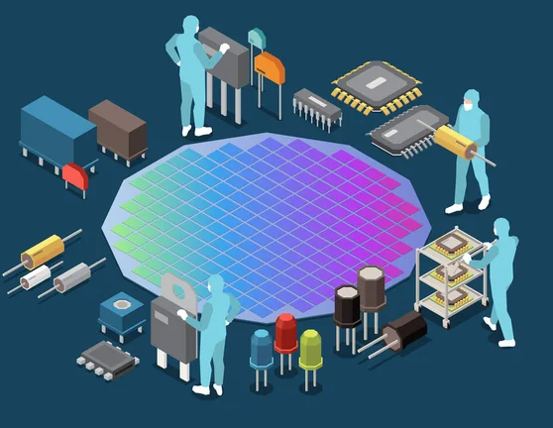
Smart Wafer Fingerprinting
DSA5201 DSML Industry Consulting and Applications Project

Slide 2

Table of contents
Introduction
Data
What is Leveling KPI
Attributes of Leveling KPI
Analytics Methods/Algorithm
Feature extraction of leveling KPI contour images
Unsupervised clustering on Leveling KPI features
Dimension reduction for noise filtering
Results
Business insights and discussion

Slide 3
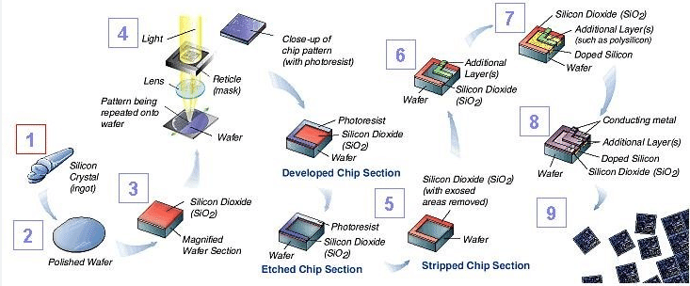
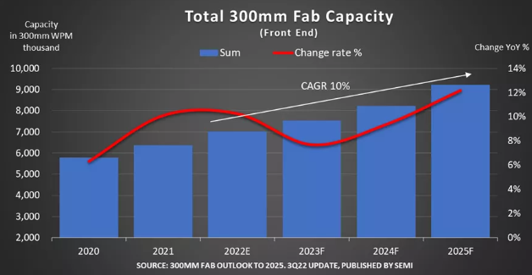

Introduction – overview of wafer manufacturing
Semiconductor manufacturing (DRAM/NAND)
Few months of Cycle time
Thousands of steps
High Throughput
Increasing yield → Increase profits

Slide 4
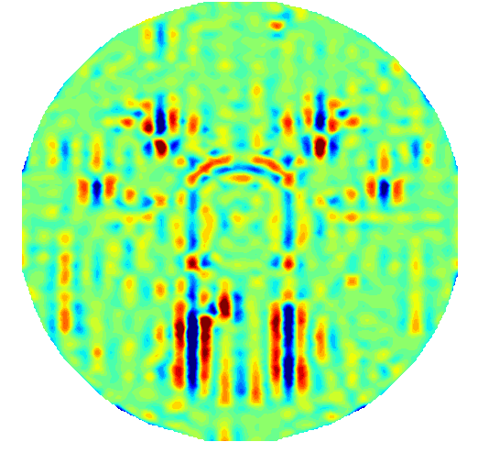
Introduction – problem statement
Causes of Yield Loss
Probe readings
Process deviations
Problem : Many wafers affected when issue first surface at probe
Solution : Need inline read points
Tool /tool parts degradation
Process drifts
Human errors (misprocess)
Causes changes in critical parameters (usually small)
Inline metrics
Problem : Some more complex issues unable to be caught by conventional tabular inline metrics
Solution : Pre-process tabular metrics into contour images to preserve spatial information, thereafter, use machine learning techniques to analyze
Point | Values
1 | W
2 | X
3 | Y
4 | Z
Unoptimized process/tool limitations
Unoptimized parameters on wafer center/edge
Mismatch of parameters on wafer edge due to tool limitations
Factors that lead to tight process margins enabling small drifts to result in yield loss

Slide 5
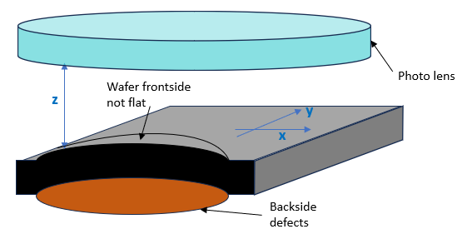
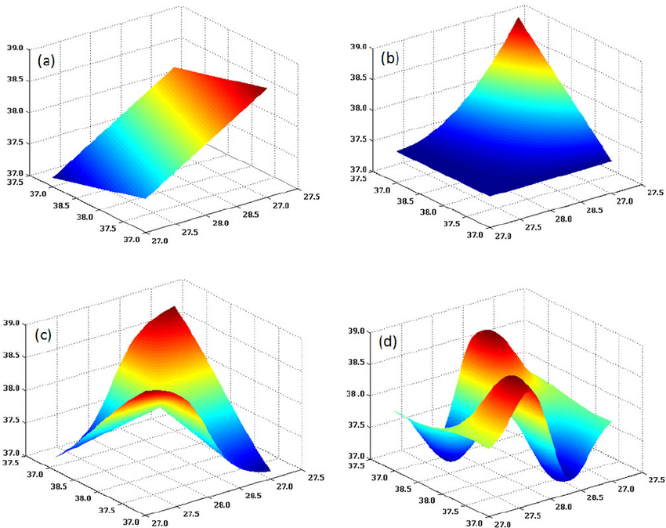
DATA – What is leveling KPI
Overlay misalignment
Leveling KPI
Random factors
Backside defects
Wafer warpage
Photo Tool wafer table residues
Usually related to wafer flatness, which can be characterized by Leveling KPI
A variant of flatness metric that estimate the Z-height between photo lens and wafer surface
Generated from polynomial models with the choice of number of parameters and degrees of order in. the X and Y direction
Optimal Model is dependent current photo scanner capabilities
Systematic factors
Photo lens induced
Incoming structure Tilt
In-plane stress
Factors that lead to tight margin for wafer flatness especially near wafer edge

Slide 6
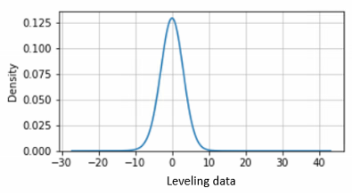
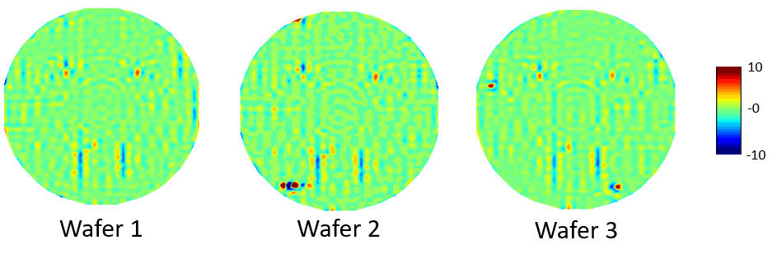
Data – Attributes of leveling KPi
Conventional generated metrics
Distribution of data points
Tabular metrology data
Die level granularity (one die have one value)
Mean, Min, Max, abs(Max), Standard Deviation
In this project, we focus on Mean value as it offer a representative summary of leveling performance for each die.
Leveling KPI contour images
Both unique and common patterns observed between wafers
Common patterns are observed nearer to center of wafer
Unique patterns such as some globular hotspots are located near the edge of wafer.
Spatial information are very important

Slide 7
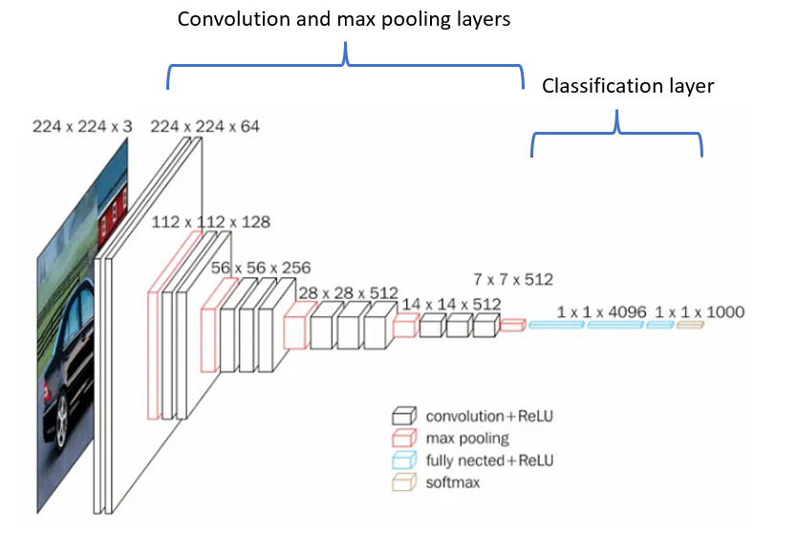
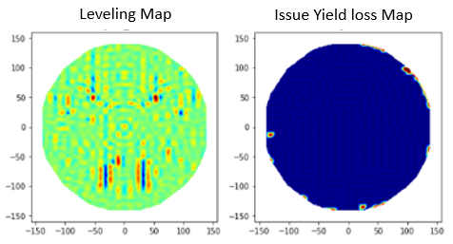
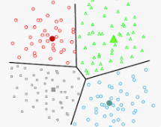
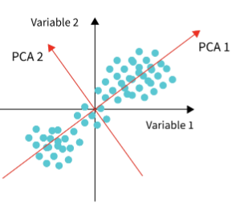
Analytics methods/algorithms – Feature extraction
What we have
1) CNN - VGG19 without Classification Layer
High resolution Leveling data (one value per die)
Spatial information
Input:
Contour image
What we do not have
Information of all known YL factors that can be separated out
Labelled data
Output :
512 features
What we need
2) Unsupervised models
Unsupervised Clustering
PCA
To extract features that retain some spatial information
To surface out anomaly tools using these extracted features
Input:
512 features
Output :
Outlier tools

Slide 8
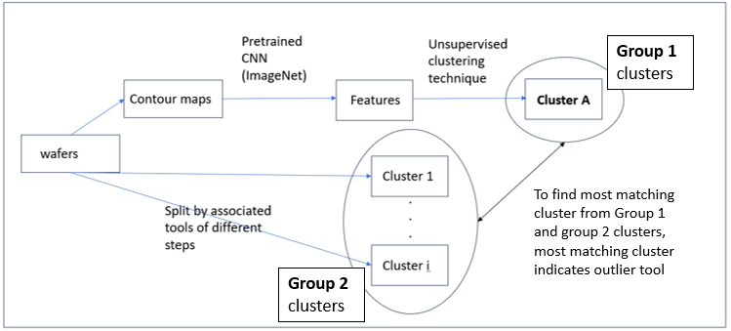
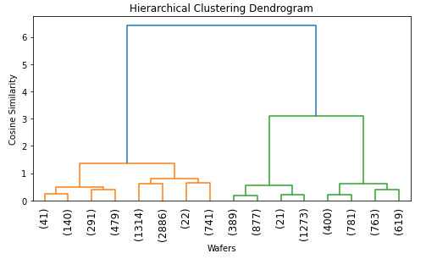
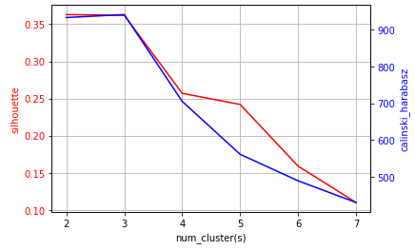
Analytics methods/algorithms – Clustering
Workflow
Hierarchical clustering (cos-sim)
Group 1 clusters: clusters are generated by unsupervised clustering
Group 2 clusters: clusters are generated by grouping wafers into their associated tools
Hierarchical clustering is chosen
Cosine similarity distance metric
3 clusters are optimal

Slide 9
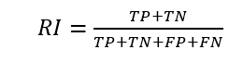
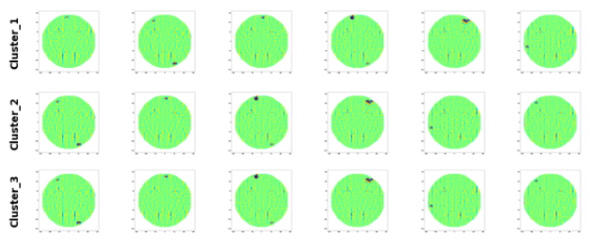
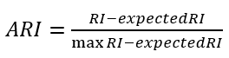
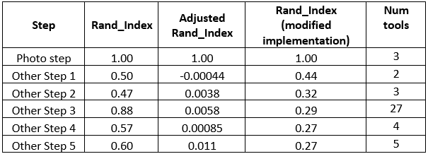
Analytics methods/algorithms – Clustering
Resulting Group 1 Clusters
1)
Sensitive to number of clusters
2)
Not optimal to match a single outlier tools out of many
Group 1 clusters
Group 2 clusters
3)
RI (modified implementation)
A1
B1
A2
B2
Cluster most matched to A2
Other clusters
Tool C
Other tools
Different clusters contain wafers with similar signatures
Single cluster contains wafers with different signatures
VGG19 can pick up patterns not easily observable by human eyes

Slide 10
Analytics methods/algorithms – Noise filtering by PCA
From clustering, we know ….
Photo tools are the primary factor for leveling signatures (wafer table residuals)
Many Leveling signatures may not cause yield loss, indicating majority of variations are noises
Clustering method is unable to detect photo tool’s own contribution to YL drift
What do we need ?
For problem 1 and 2
A way to separate out anomaly signatures from baseline variations (in which mostly are noise)
For problem 3
A metric to detect wafer changes over time no matter which tool
Solution
Conduct dimensionality reduction on dataset to separate out secondary variations from baseline variation (where they are small in proportion to total variation but might characterize the yield loss inducing anomaly)

Slide 11
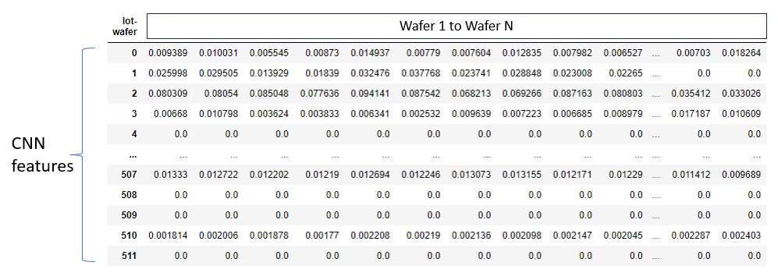
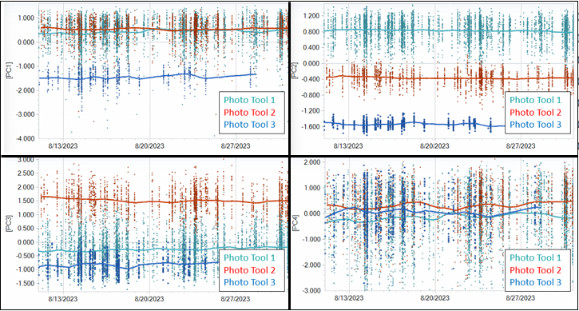
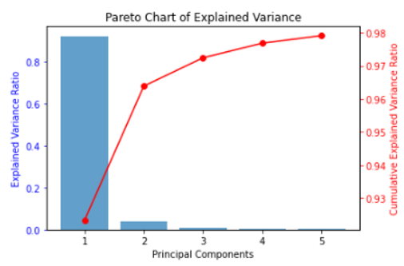
Analytics methods/algorithms – Noise filtering by PCA
Data matrix for PCA
Results
Individual wafers as the dimension to reduce
~90% of variance explained by PC1
Partition out each photo tool based on their leveling signature (sufficient information is retained after PCA)
Able to observe performance change over time.
Surface out minor yet consequential signature change over time from other baseline variation (noise)
Majority of baseline variation captured by PC1

Slide 12
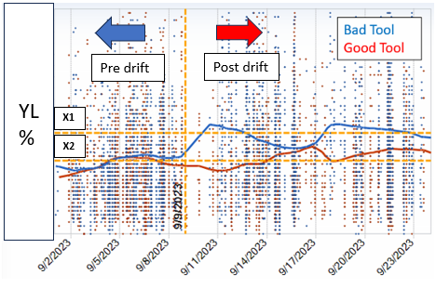
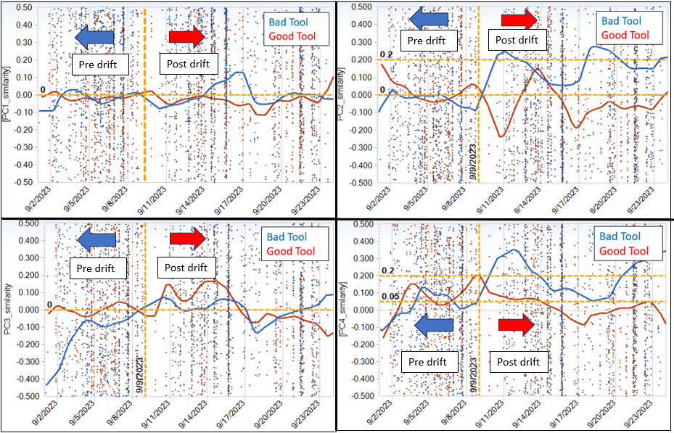
Results – Case study
Yield Loss
Principal Components
PC2 and PC4 drifting of bad tool drifted in same timeframe of yield loss

Slide 13
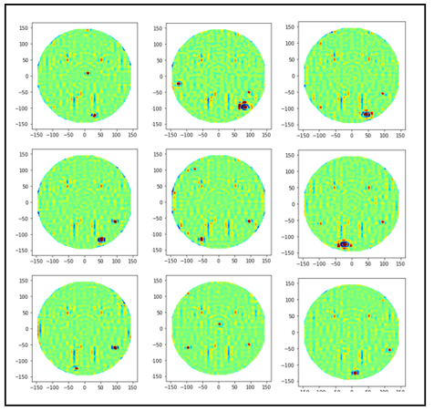
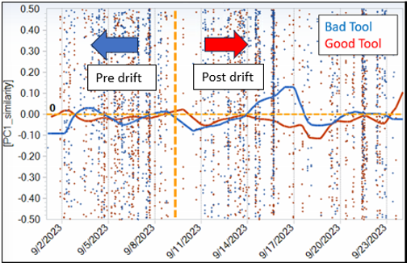
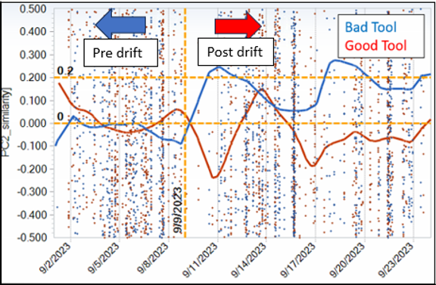
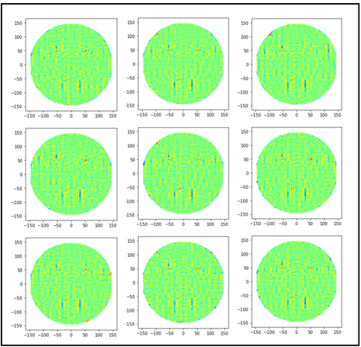
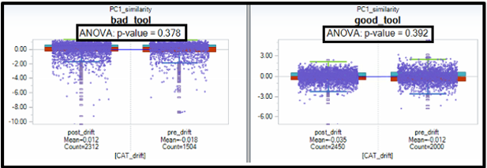
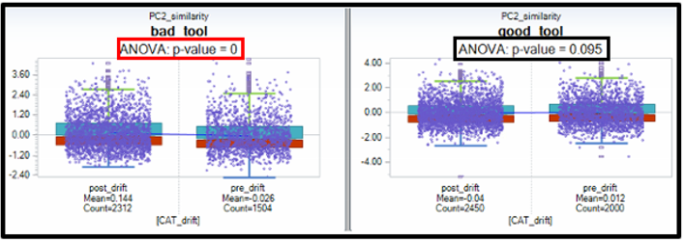
Results – Case study
PC1
PC2

Slide 14
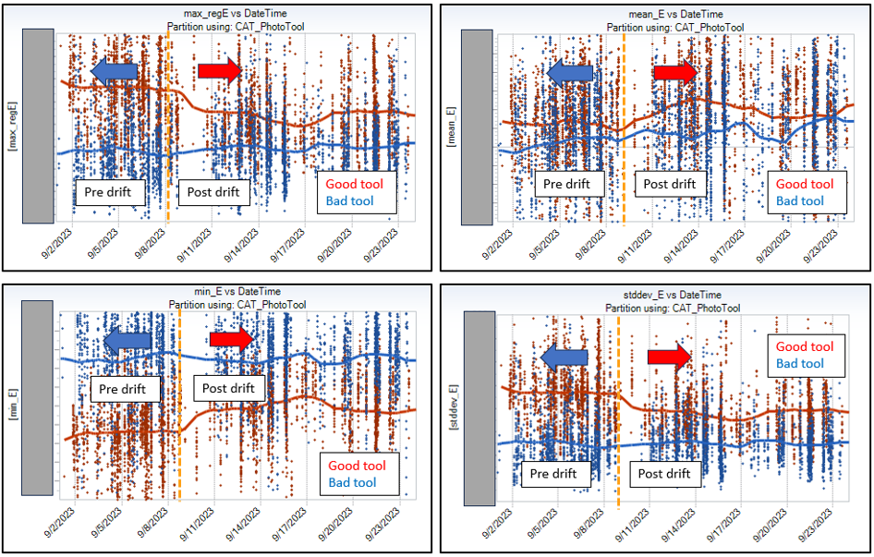

Business insights and discussion
N wafers/month
Deviation step
Wafer start
N*K wafers affected
Probe
J months
K months
Current conventional tabular metrics are unable to surface out drift from bad tool
Time trend lines are inconsistent in indicating bad tool underperform during drift timeframe.
At least N*K wafers will be affected when issue first surface at probe.
Proposed solution can enable faster drift detection, therefore save costs by reducing the number of wafers affected

Slide 15
Thank you!

